Slide 1
J.A.R.F.I.S. : Just a Rather Fair Investment System
** Naming credits: Tony Stark

Slide 2
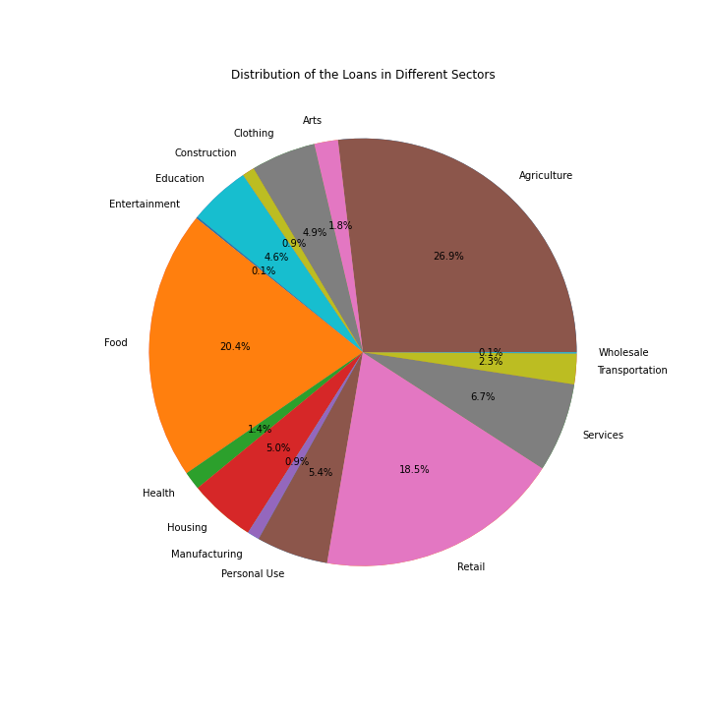
Problem

Slide 3
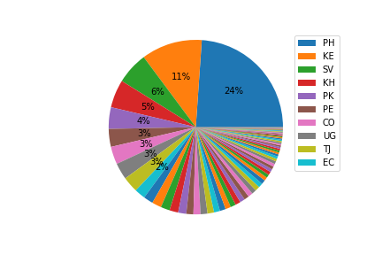
Problem
PH: Philippines
KE: Kenya
SV: El Salvador
KH: Cambodia
PK: Pakistan
PE: Peru
CO: Colombia
UG: Uganda
TJ: Tajikistan EC: Ecuador

Slide 4
Goal
Create a fairer system with respect to:
borrower gender
loan sector
borrower country
MPI (multidimensional poverty index)

Slide 5
Procedure
Cluster based on 4 features
ALS with neighborhood fairness
Model Evaluation
Step 1
Step 3
Step 5
Step 2
Step 4
Basic ALS
Personalized fairness

Slide 6
Cluster based on 4 features
ALS with neighborhood fairness
Model Evaluation
Step 1
Step 3
Step 5
Step 2
Step 4
Basic ALS
Personalized fairness

Slide 7
STEP 1: Clustering
Variables are categorical
One Hot Encoding of 4 variables
Agglomerative clustering
Optimal cluster size: 33

Slide 8
ALS with neighborhood fairness
Model Performance
Cluster based on 4 features
Model Evaluation
Step 1
Step 3
Step 5
Step 2
Step 4
Basic ALS
Personalized fairness

Slide 9
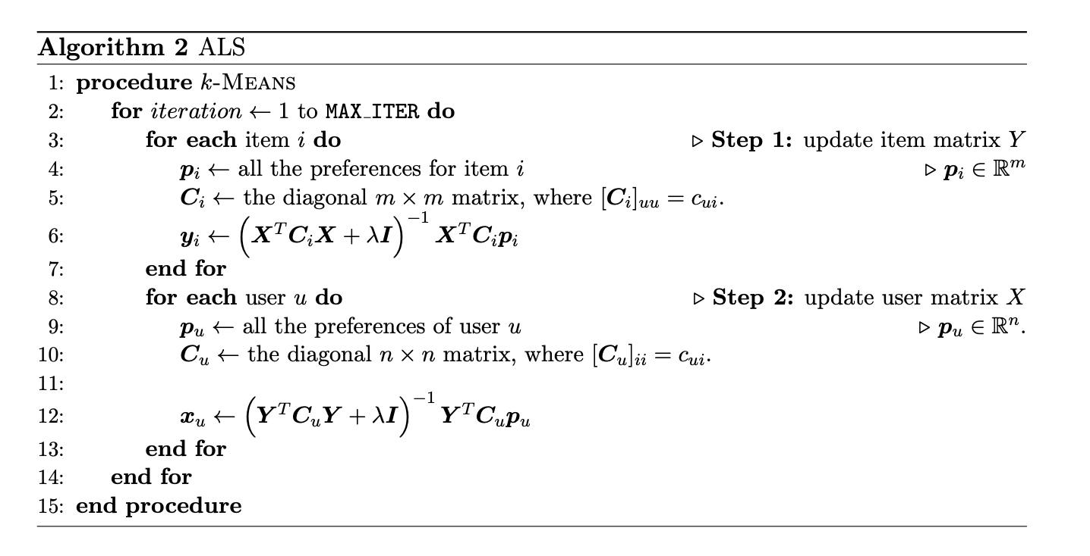
Step 2: Basic ALS

Slide 10
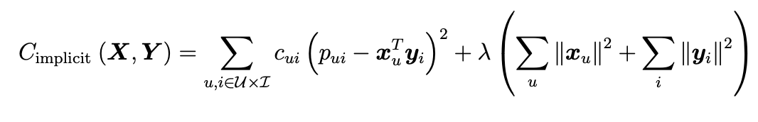
Basic Loss function

Slide 11
ALS with neighborhood fairness
Model Performance
Cluster based on 4 features
Model Evaluation
Step 1
Step 3
Step 5
Step 2
Step 4
Basic ALS
Personalized fairness

Slide 12
ALS with Neighborhood Fairness
Improved Loss function:
S+ is the set of protected group with low recommendation preferences and the complementary of S- is the set of unprotected group with high recommendation preferences.

Slide 13
ALS with neighborhood fairness
Model Performance
Cluster based on 4 features
Model Evaluation
Step 1
Step 3
Step 5
Step 2
Step 4
Basic ALS
Personalized fairness

Slide 14
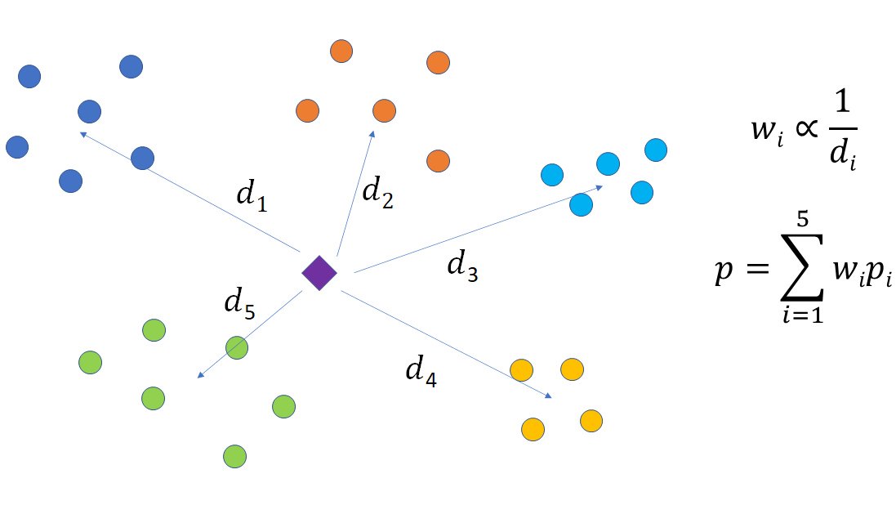
Personalized Fairness
For each user, rank the preference value p for each loan and recommend the top 100 loans.

Slide 15
Cluster based on 4 features
ALS with neighborhood fairness
Model Evaluation
Step 1
Step 3
Step 5
Step 2
Step 4
Basic ALS
Personalized fairness

Slide 16
Fairness
 | Basic ALS | Personalized Fairness Model
Variance of Preferences | 48.85 | 36.58
Range of Preferences | 31.76 | 29.39
Coverage Rate | 18.2% | 24.9%

Slide 17
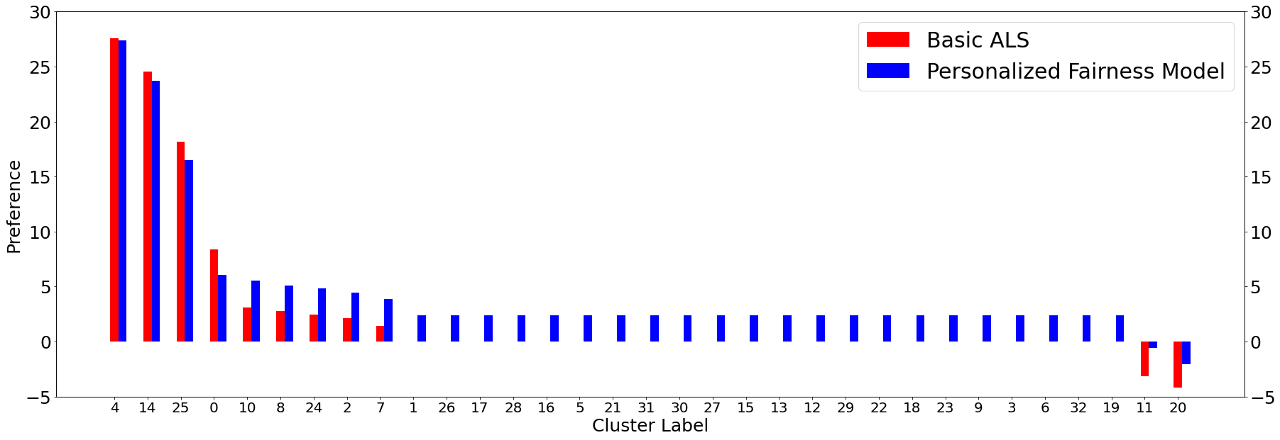
Fairness

Slide 18
Accuracy
Metrics:
Mean overlap between top 100 recommendations based on the basic ALS model and top 100 on the personalized fairness model for all users (lenders)
Accuracy:
~72.5%
Top 100 from Basic ALS
Top 100 from Personalized Fairness

Slide 19
Insights
The number of clusters matters a lot! Accuracy does not change monotonically with number of clusters.
Beyond a certain degree of fairness (coefficient for neighborhood fairness regularization), the preferences don’t change :O
Your predicted preferences can be negative?! It just means, the loan is less preferred.

Slide 20
Difficulties
Choosing an appropriate clustering algorithm for categorical variables
How to differentiate between loans within a cluster
Loans are hard to recommend: once funded, they exit the dataset and can’t be recommended again
Hyperparameter tuning: Selecting appropriate number of clusters

Slide 21

Cheers!

Slide 22
Appendices

Slide 23
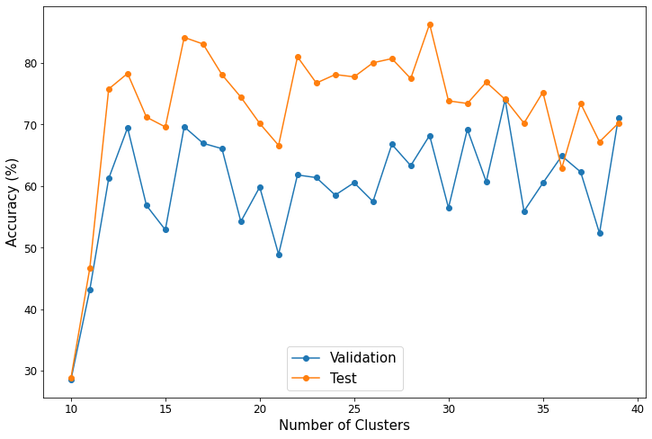
Accuracy Changes with Number of Clusters

Slide 24
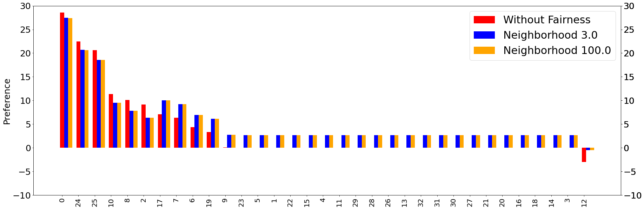
Preferences with Different Fairness Coefficients

